Slide 1

TRADITIONAL METHODOLOGY
-By
Yeshwanthy A B

Slide 2

Objectives
It is used to design and develop simple software
Aims to deliver projects successfully, involving planning, execution,

Slide 3
Process
Requirements analysis
Design
Implementation
Coding and Testing
Maintenance
Traditional Software Development is the software development process used to design and develop simple software. It is used when the security and many other factors of the software are not much important. It is used by freshers to develop the software. It consists of five phases:

Slide 4
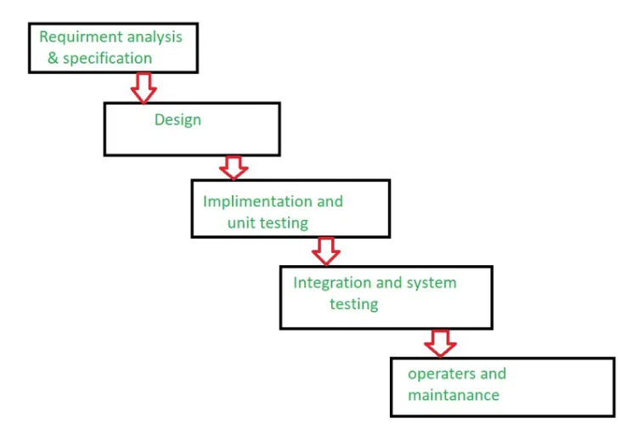
Process

Slide 5
Advantages
Well-Established Methodology: Traditional software development follows a well-established methodology that is widely understood and documented.
Clear Requirements: Traditional software development relies on clear and detailed requirements, which helps to ensure that the final product meets the customer’s needs.
Structured Approach: Traditional software development follows a structured approach, with clear phases and milestones, which helps to ensure that the project stays on track.

Slide 6
AGILE METHODOLOGY

Slide 7
Process
Planning
Requirement Analysis
Designing
Implementation
Testing
Deployment
Agile methodology is the software development process used to design complicated software. It is used when the software is quite sensitive and complicated. It is used when security is much more important. It is used by professionals to develop the software. It consists of three phases:

Slide 8
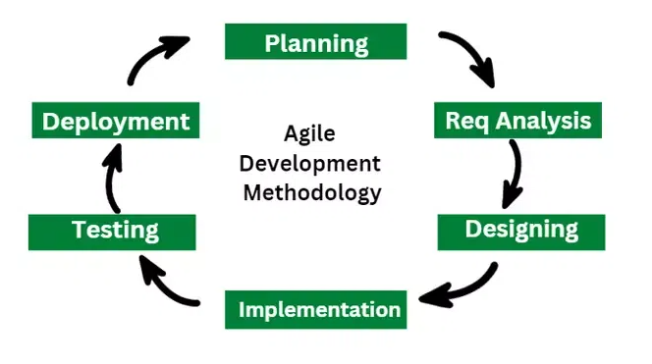
Process

Slide 9
Advantages
Flexibility: Agile software development is highly flexible and can easily adapt to changes in requirements, design, and scope.
Customer Involvement: Agile software development encourages frequent customer involvement, which can result in a final product that better meets their needs.
Continuous Delivery: Agile software development typically includes continuous delivery, which means that working software is delivered to the customer on a regular basis.

Slide 10
THANK YOU!

